Slide 1

Web Project for Exchange Student
SKKUEXS
김주원 | 서현원 | 이하은 | 한희근

Slide 2
Schedule
To – do Week | 3 | 4 | 5 | 6 | 7 | 8 | 9 | 10 | 11 | 12 | 13
Proposal & Study
Data Collecting
Data Processing (NLP)
Front-end (Planning & UI/UX)
Back-end (Server & DB Design)
Beta Test
2

Slide 3
Schedule
To – do Week | 3 | 4 | 5 | 6 | 7 | 8 | 9 | 10 | 11 | 12 | 13 | 14 | 15
Proposal & Study
Data Collecting
Data Processing (NLP)
Front-end (Planning & UI/UX)
Back-end (Server & DB Design)
Beta Test
3

Slide 4
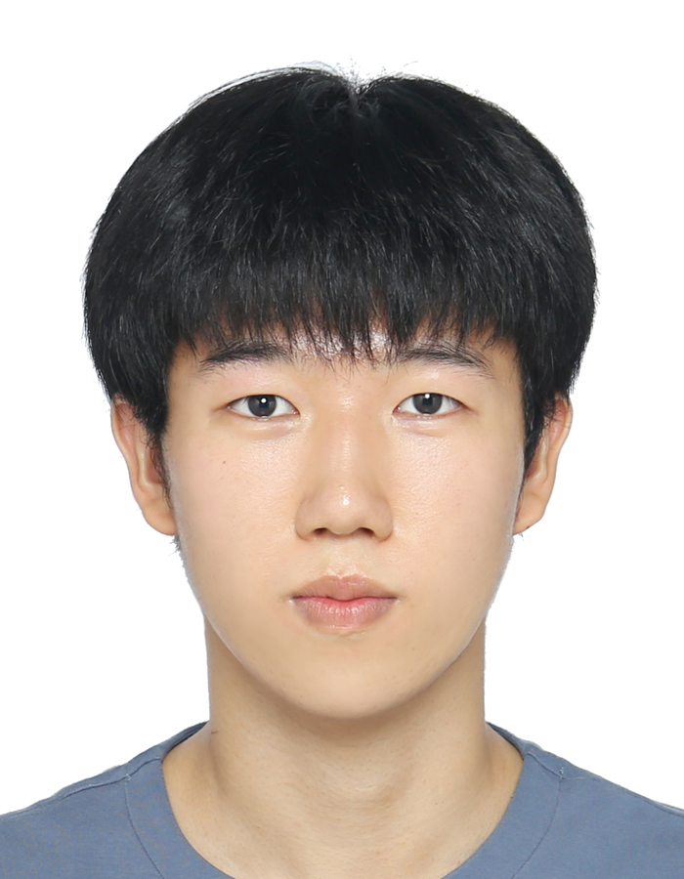
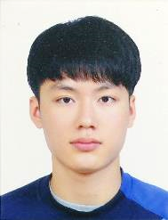

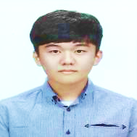
Work Assignment
Juwon Kim
DB Deployment
Hyunwon Seo
Social Login
Haeun Lee
Front-end Implementation
Huigeun Han
Front-end Implementation
4

Slide 5
Demo
Link
5

Slide 6
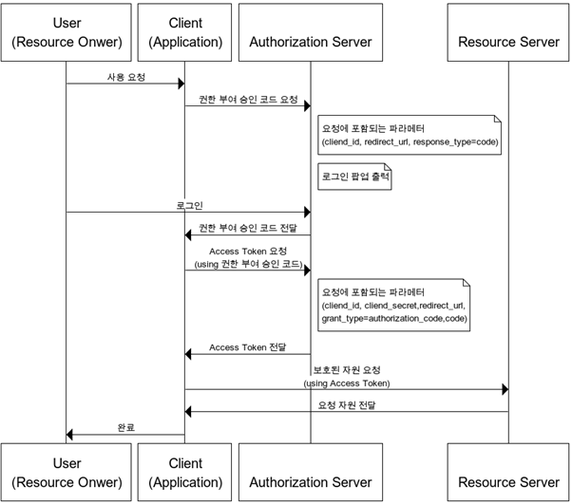
Social Login
6

Slide 7
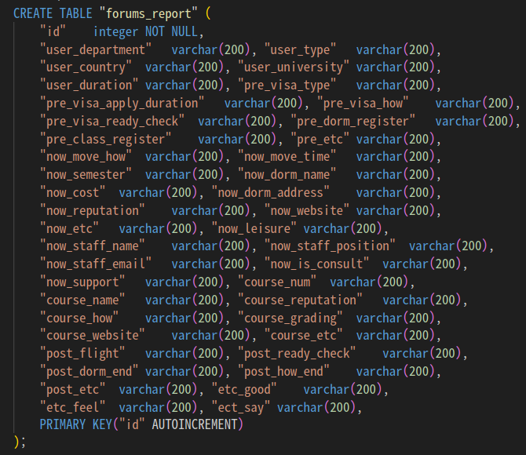
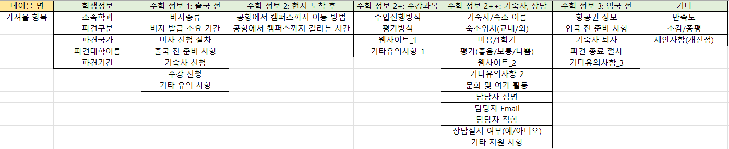
DB Structure
7

